Slide 1
Sean Koppenhafer, Jaime Rodriguez,
Chad Thueson, Noah Erickson, Rishal Dass
Weekly meeting, 4/15/2015
Digital Dash
Portland State University
Department of Electrical and Computer Engineering (ECE)
Notes:
1
1

Slide 2
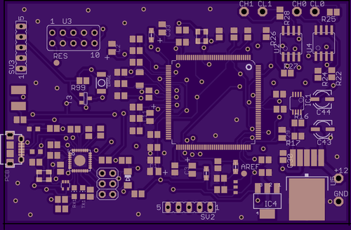
Prototype boards/Enclosure
Final board has been ORDERED
Cost: $35.95
Has been sent off to fabrication (notified by OSH Park)
May take 2 weeks to deliver
Already have components for final board

Slide 3

Demo Code
Wrote code to test our system, if by chance EV Car is not completed on time
When testing with EVCU, we are not getting any data from the RMS line.
We don’t know if the connected car had other components that worked with EVCU

Slide 4

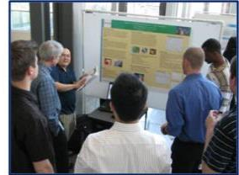
Documentation/Other Important Info
Added more onto the final report.
Email Dr. Faust, we need to finish and turn in poster by May 27 so it can be printed out
Poster can be picked up June 1st
Poster session is on June 5th
Project Schedule
Behind on testing code for BMS System
On schedule on ordering board and parts
Ahead of schedule on drawing possible final enclosure designs

Slide 5
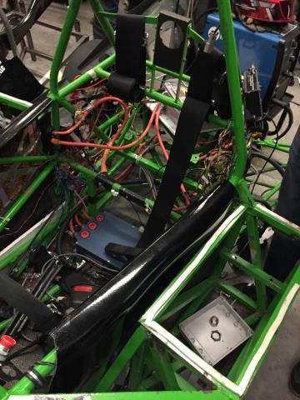
Electric Vehicle Update
In Progress
Car is being dismantled
BMS Removed
VMS team worked all Friday on both cars, hopefully there’s some progress has been made

Slide 6
Goals For The Upcoming Week
System
- Get demo code working
- Then work on BMS with the demo code
Enclosure
- Install wiring and screen on to the enclosure
- Start testing enclosures with test plan
- Look for final mounting location
Documentation
- Update report
- Start on poster
- Update wiki
Notes:
6

